Slide 1
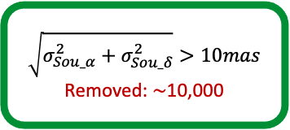
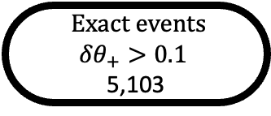
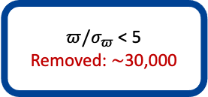
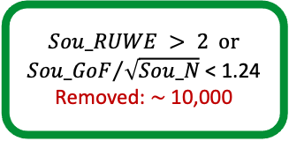
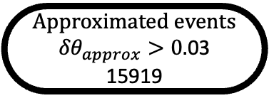
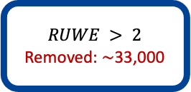
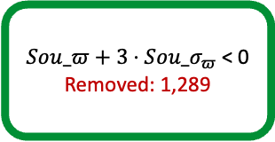
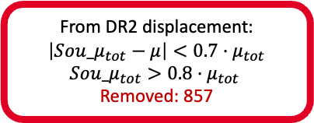
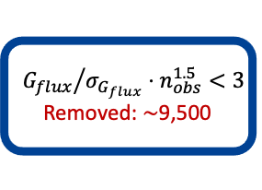
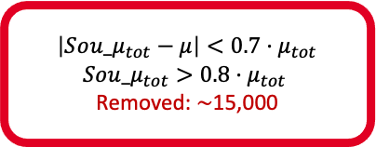
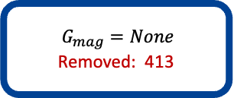
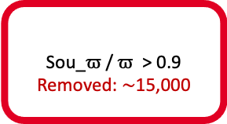
$$RUWE > 2$$
Removed: ∼33,000
$π/σ_{π}$ < 5
Removed: $∼$30,000
$$G_{mag}=None$$
Removed: 413
$${G_{flux}}/{σ_{G_{flux}}⋅n_{obs}^{1.5}<3 }$$
Removed: $∼$9,500
HPMS ∼500,000
Good HPMS ∼440,000
Bad DR2 match
Removed: 1,061
$$\sqrt{σ_{Sou_α}^{2}+σ_{Sou_δ}^{2}}>10mas$$
Removed: $∼$10,000
$Sou_RUWE > 2$ or ${Sou_GoF}/{\sqrt{Sou_N} }$< 1.24
Removed: $∼$10,000
$Sou_π+3⋅Sou_σ_{π}$ < 0
Removed: 1,289
Search for BGS
Close-by BGS ∼197,000
Candidates of good HPMS and BGS ∼ 153,000
From DR2 displacement:
$$\left|So{u_μ}_{tot}−μ\right|<0.7·μ_{tot}$$
$$Sou_μ_{tot}>0.8·μ_{tot}$$
Removed: 857
$$\left|So{u_μ}_{tot}−μ\right|<0.7·μ_{tot}$$
$$Sou_μ_{tot}>0.8·μ_{tot}$$
Removed: $∼$15,000
$$\text{Sou}\text{_}ϖ \text{/} ϖ \text{> }\text{0.9}$$
Removed: $∼$15,000
Good Candidates
∼136,000
Removed after visual inspection
Removed: 261
astrometric microlensing events
4842
Approximated events
${δθ}_{approx}>0.$03
15919
Exact events
$${δθ}_{+}>0.1$$
5,103
Estimate assumed masses and Einstein radii
Determine approximated minimum angular separations
Determine exact minimum angular separations

